Slide 1
SOURCE-BACKED PRESENTATION
Approve barcode pilot?
EXECUTIVE BRIEF
Northstar Goods should approve a six-week barcode-scanning pilot in its Valparaíso warehouse, with adjustments to address Wi-Fi dead zones and a structured evaluation to confirm error reduction. Baseline data shows 216 errors over 14,400 lines (1.5% error rate) and median pick time of 74 seconds. The pilot cost is USD 7,800 for six pickers. A two-day trial showed 5 errors over 960 lines (0.52% error rate) but median pick time increased to 79 seconds, and two Wi-Fi dead zones were reported. The pilot should proceed with Wi-Fi remediation and clear success metrics.
Decision support / Evidence bound / Source cited
Notes:
Open by framing the decision and why the evidence matters. Preview the recommendation without overstating certainty: Northstar Goods should approve a six-week barcode-scanning pilot in its Valparaíso warehouse, with adjustments to address Wi-Fi dead zones and a structured evaluation to confirm error reduction. Baseline data shows 216 errors over 14,400 lines (1.5% error rate) and median pick time of 74 seconds. The pilot cost is USD 7,800 for six pickers. A two-day trial showed 5 errors over 960 lines (0.52% error rate) but median pick time increased to 79 seconds, and two Wi-Fi dead zones were reported. The pilot should proceed with Wi-Fi remediation and clear success metrics.

Slide 2
SECTION 01
Decision: Approve barcode pilot?
• Northstar Goods leadership must decide whether to approve a six-week barcode-scanning pilot in the Valparaíso warehouse.
• The pilot would equip six pickers with scanners at an estimated cost of USD 7,800.
• The decision is a go, adjust, or stop recommendation based on evidence from baseline operations and a two-day trial.
DECISION LENS
The decision is a go, adjust, or stop recommendation based on evidence from baseline operations and a two-day trial.
EVIDENCE
S1 / S2 / S3
Presentation deck
2
Notes:
This slide frames the decision for the leadership team. We are not asking for a permanent rollout yet; we need a clear go, adjust, or stop on a six-week pilot. The cost is modest, but the evidence must justify the investment and the operational risk.

Slide 3
SECTION 02
Baseline: Current picking performance
• Over four weeks, 18 pickers processed 14,400 order lines with 216 documented picking errors.
• Median pick time was 74 seconds per line.
• This yields an error rate of 1.5% and a throughput of 800 lines per week per picker.
DECISION LENS
This yields an error rate of 1.5% and a throughput of 800 lines per week per picker.
EVIDENCE
S1
Presentation deck
3
Notes:
The baseline gives us a reference point. With 216 errors in 14,400 lines, we have a 1.5% error rate. This is the number we want to improve. Note that the baseline is from a four-week period, so it is a stable measure.

Slide 4
SECTION 03
Trial: Barcode scanning shows promise
• In a two-day trial, six users processed 960 lines with 5 documented picking errors, an error rate of 0.52%.
• Median pick time was 79 seconds, slightly higher than baseline.
• Users reported two Wi-Fi dead zones, and the trial was not randomized.
DECISION LENS
Users reported two Wi-Fi dead zones, and the trial was not randomized.
EVIDENCE
S3
Presentation deck
4
Notes:
The trial suggests barcode scanning could cut errors by about two-thirds, but we must be cautious. The trial was short and not randomized, and the median pick time increased by 5 seconds. The Wi-Fi dead zones are a known issue that could affect performance.

Slide 5
SECTION 04
Cost and feasibility: USD 7,800 pilot
• The six-week pilot is estimated at USD 7,800, including scanners, labels, setup, and support.
• The estimate assumes existing Wi-Fi coverage is sufficient, but the trial identified two dead zones.
• This is a low-cost, low-risk investment relative to potential error reduction.
DECISION LENS
This is a low-cost, low-risk investment relative to potential error reduction.
EVIDENCE
S2 / S3
Presentation deck
5
Notes:
The pilot cost is modest, but the assumption about Wi-Fi is a risk. We need to budget for potential remediation of the dead zones. Even with that, the cost is justified if we can reduce errors by even half.

Slide 6
SECTION 05
Recommendation: Go with adjustments
• remediate the two Wi-Fi dead zones before launch
• define success metrics (e.g., error rate below 1%, median pick time within 5% of baseline), and
• conduct a mid-pilot review at week three. This balances evidence of error reduction with operational risk.
DECISION LENS
conduct a mid-pilot review at week three. This balances evidence of error reduction with operational risk.
EVIDENCE
S1 / S2 / S3
Presentation deck
6
Notes:
Our recommendation is to go, but not blindly. We need to fix the Wi-Fi dead zones first, set clear success metrics, and check progress halfway. This way, we can stop early if the pilot is not working, and we have a clear basis for a full rollout decision.

Slide 7
SECTION 06
Next steps: Launch and evaluate
• remediate Wi-Fi dead zones in week one
• launch the pilot in week two with six pickers
• collect daily error and pick-time data
• conduct a mid-pilot review at week three, and
• deliver a final report at week six with a go/no-go recommendation for full rollout.
DECISION LENS
deliver a final report at week six with a go/no-go recommendation for full rollout.
EVIDENCE
S1 / S2 / S3
Presentation deck
7
Notes:
This slide outlines the execution plan. The key is to have a structured evaluation so we can make a data-driven decision at the end. The mid-pilot review is a checkpoint to adjust or stop if needed.

Slide 8
SECTION 07
Evidence: Key data points
• The evidence base includes three sources: baseline picking performance (S1), the barcode pilot estimate (S2), and the two-day scanner trial (S3).
• Key data points are: baseline error rate 1.5%, trial error rate 0.52%, pilot cost USD 7,800, and two Wi-Fi dead zones identified.
DECISION LENS
Key data points are: baseline error rate 1.5%, trial error rate 0.52%, pilot cost USD 7,800, and two Wi-Fi dead zones identified.
EVIDENCE
S1 / S2 / S3
Presentation deck
8
Notes:
This slide consolidates the evidence for the leadership team. It highlights the error reduction potential and the cost, while flagging the Wi-Fi issue and the non-randomized trial design.

Slide 9
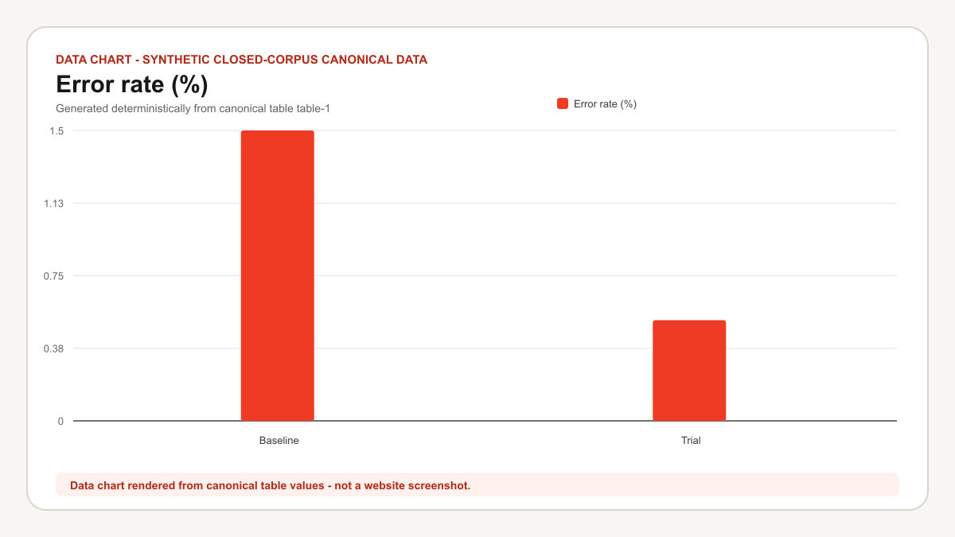
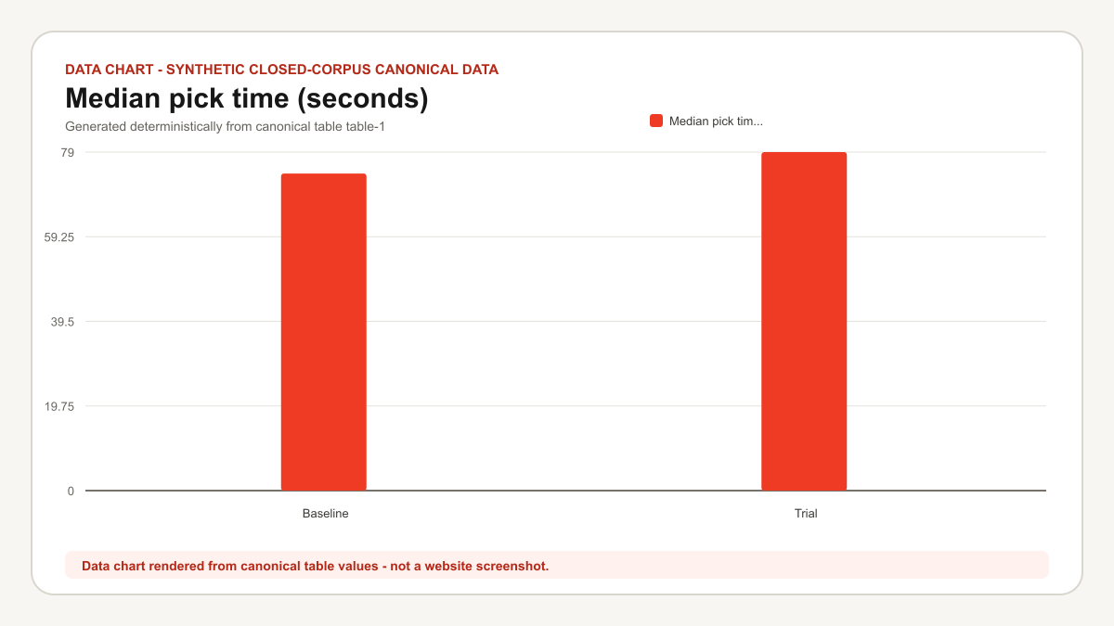
Evidence visuals
Data chart: Error rate (%)
Data chart: Median pick time (seconds)
Data chart rendered from canonical table values - not a website screenshot.
Data chart rendered from canonical table values - not a website screenshot.
9
Notes:
Walk through Data chart: Error rate (%) as a representation of the cited evidence. Preserve this caveat verbatim: Data chart rendered from canonical table values - not a website screenshot.
Walk through Data chart: Median pick time (seconds) as a representation of the cited evidence. Preserve this caveat verbatim: Data chart rendered from canonical table values - not a website screenshot.

Slide 10
Sources
S1 Warehouse picking baseline
https://northstar.example.test/evidence/picking-baseline
S2 Barcode pilot estimate
https://northstar.example.test/evidence/barcode-estimate
S3 Two-day scanner trial
https://northstar.example.test/evidence/scanner-trial
Notes:
Close by identifying the primary sources behind the recommendation. Invite questions about evidence quality, assumptions, and unresolved uncertainty.

